Slide 1
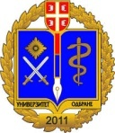
Development of master curricula for natural disasters risk management in Western Balkan countries
Impact of NatRisk on the Western Balkan HEIs
TECHNICAL COLLEGE OF APPLIED SCIENCES UROSEVAC-LEPOSAVIC
Jelena Rajovic

Slide 2
Development of master curricula for natural disasters risk management in Western Balkan countries
Initial activities
Contact with relevant institutions from Kosovo* regarding the procedure for defining the requirements for admission and enrolment of students and for the innovation of the existing classification of occupations in Kosovo*
We performed an expert consultation with colleagues form our School regarding the project tasks assignments. Also, a thorough review of the literature on occupational safety and its importance in prevention or minimizing the risks in workplace that may occur as a result of natural risk disasters was conducted.
The questionnaires created by UNID we distributed to target groups (citizens, public sectors, students, etc). The total 309 respondents participated the survey and the questionnaires were delivered to UNI.

Slide 3
Development of master curricula for natural disasters risk management in Western Balkan countries
Study visits
University of Natural Resources and Life Sciences, Vienna (BOKU), Austria, April 2017.
Obuda University- OE, Budapest, Hungary, May 2017.
Middlesex University-MU, London, United Kingdom, June 2017.
University of Messina, UNIME, September 2017.

Slide 4
Activities performed
Development of master curricula for natural disasters risk management in Western Balkan countries
We have signed the inter-institutional agreements with partners KPA, TUC and VSUP for special mobility strand.
SMS calls were conducted; Commission was formed and the candidates were selected.
Based on project, we have 3 teaching staff mobilities, and so far one was successfully realised, at the beginning of June with our partners from TUC - Greece.
Students will be given opportunity to study in EU within the Special Mobility Strand and 4 students from our school will be exchanged by October 2019.

Slide 5
Activities performed
Development of master curricula for natural disasters risk management in Western Balkan countries
Handbook for training completed and submitted to NatRisk project coordinator.
Training description prepared and submitted to NatRisk project coordinator.
Training promoted to relevant institutions.
A two-day training for public sector and stakeholders regarding the management of the risk disasters management was organized and report and all necessary documentation was created and submitted.

Slide 6
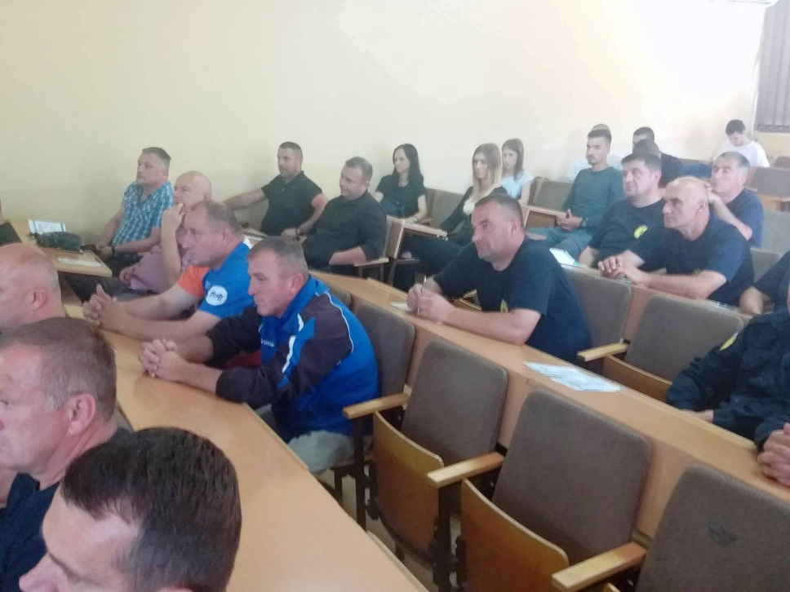
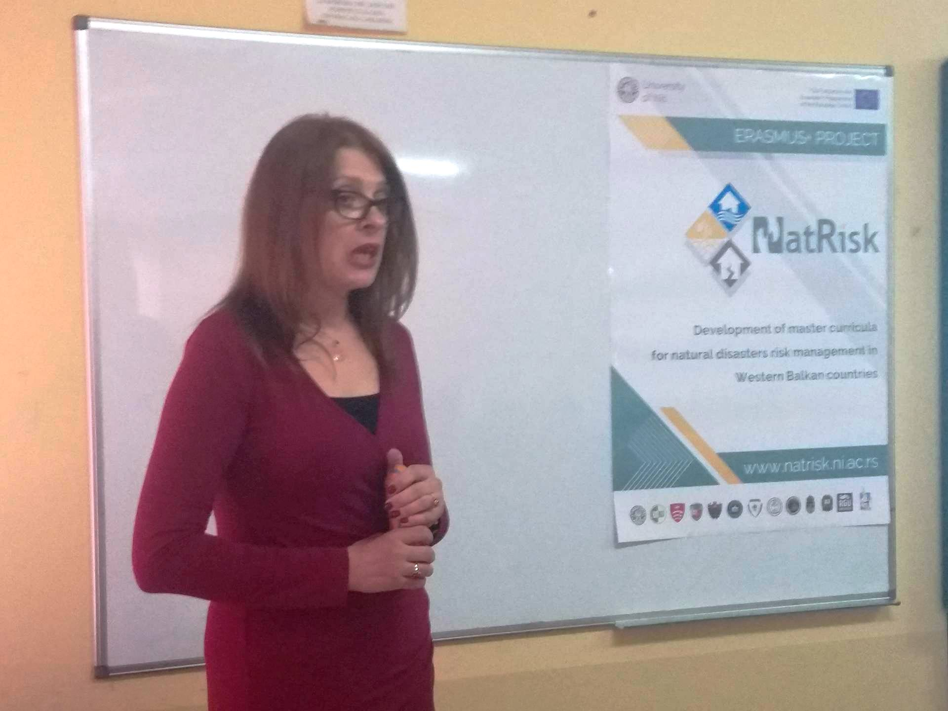
Development of master curricula for natural disasters risk management in Western Balkan countries
A two-day training for public sector and stakeholders regarding the natural disasters risk management was organized and valuable feedback was obtained.

Slide 7
Equipment
Development of master curricula for natural disasters risk management in Western Balkan countries
Following the equipment purchase procedure for the implementation of the International project, "Development of master curricula for natural disasters in the Western Balkan countries”, TCASU, acquired following equipment:
15 computers,
4 projectors ,
1 Smart Board,
2 printers and
1 TV set.
Software "HYDRUS 2.X, PCPROGRESS, Educational site licence Level L4 3D Standard” and “ IBM-SPSS Statistics (Premium Faculty Pack Bundle) Permanent License" were also purchased.

Slide 8
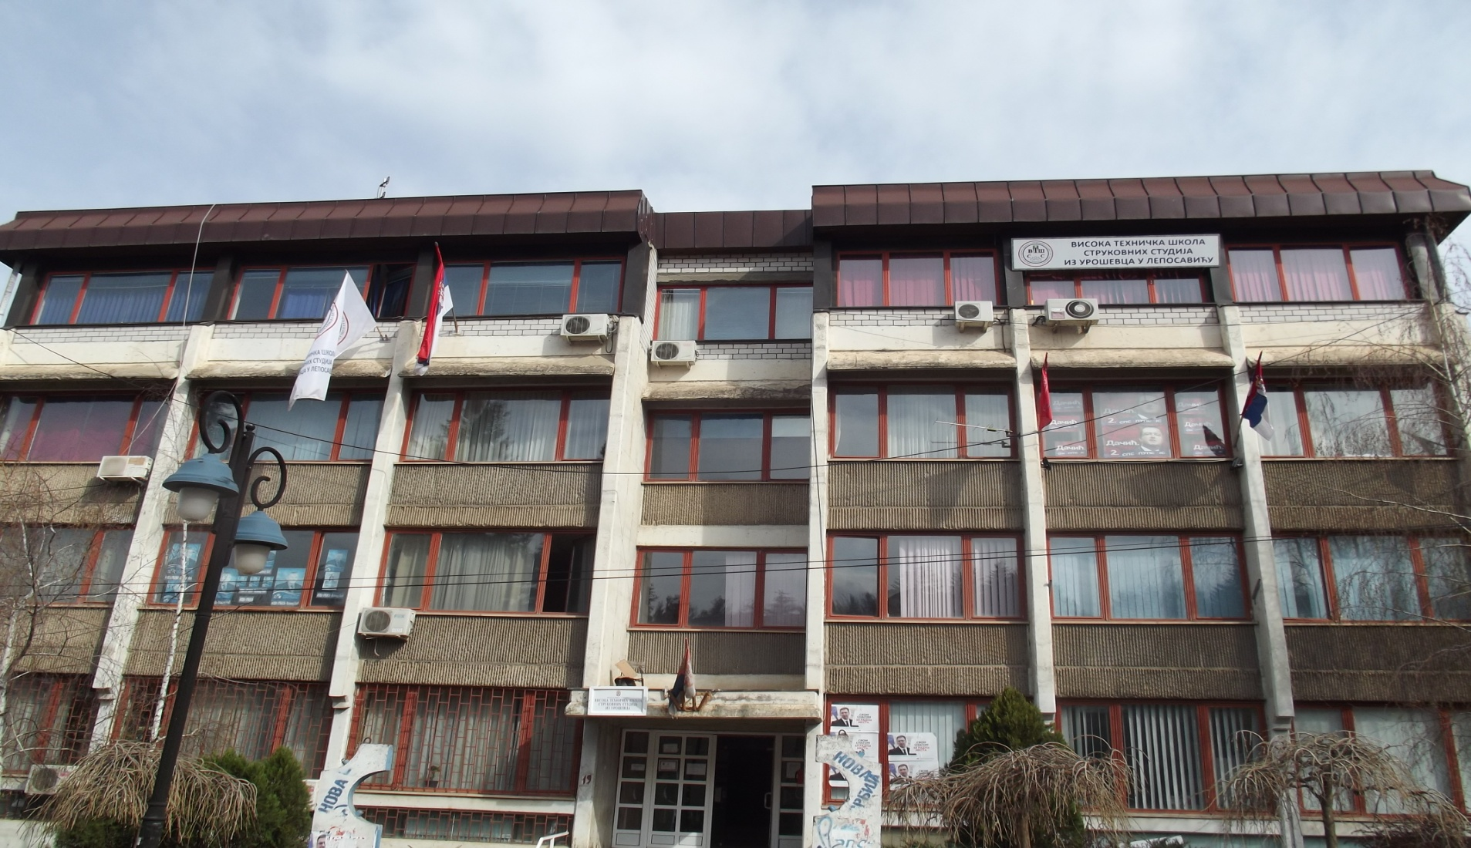
Equipment
Development of master curricula for natural disasters risk management in Western Balkan countries

Slide 9
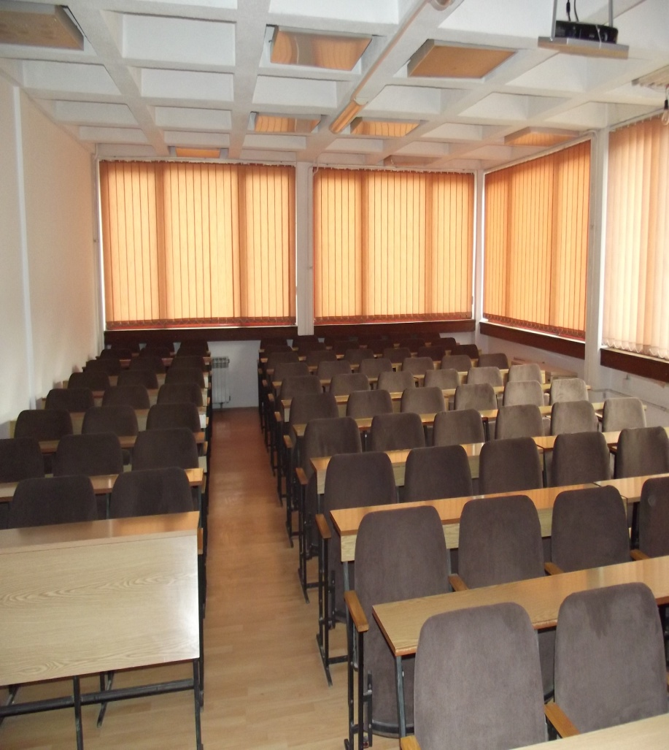
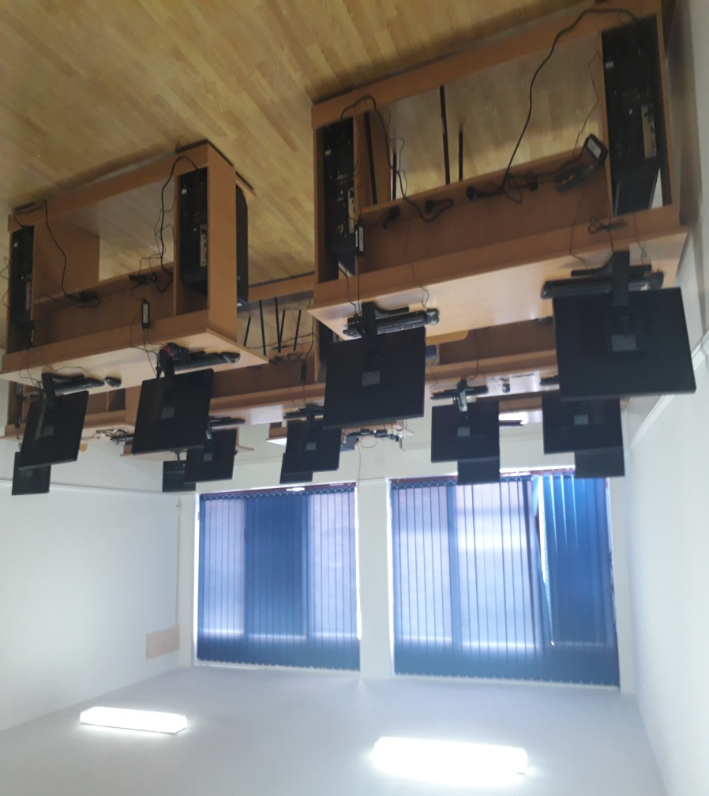
Equipment
Development of master curricula for natural disasters risk management in Western Balkan countries

Slide 10
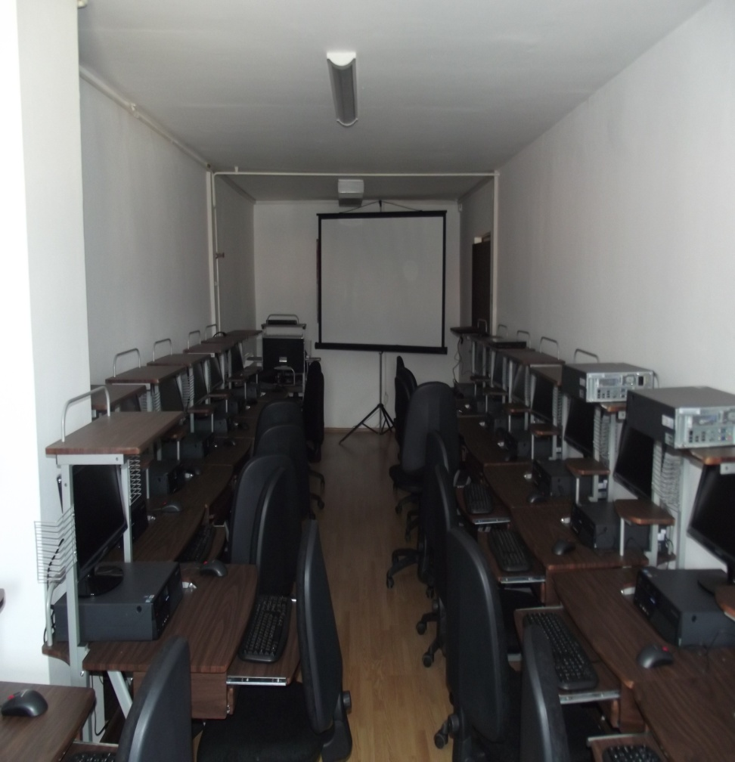
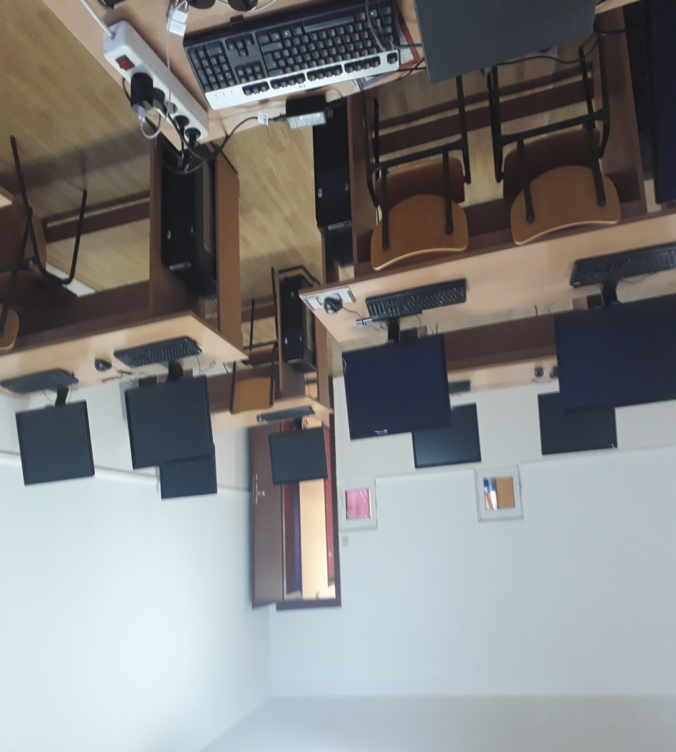
Equipment
Development of master curricula for natural disasters risk management in Western Balkan countries

Slide 11
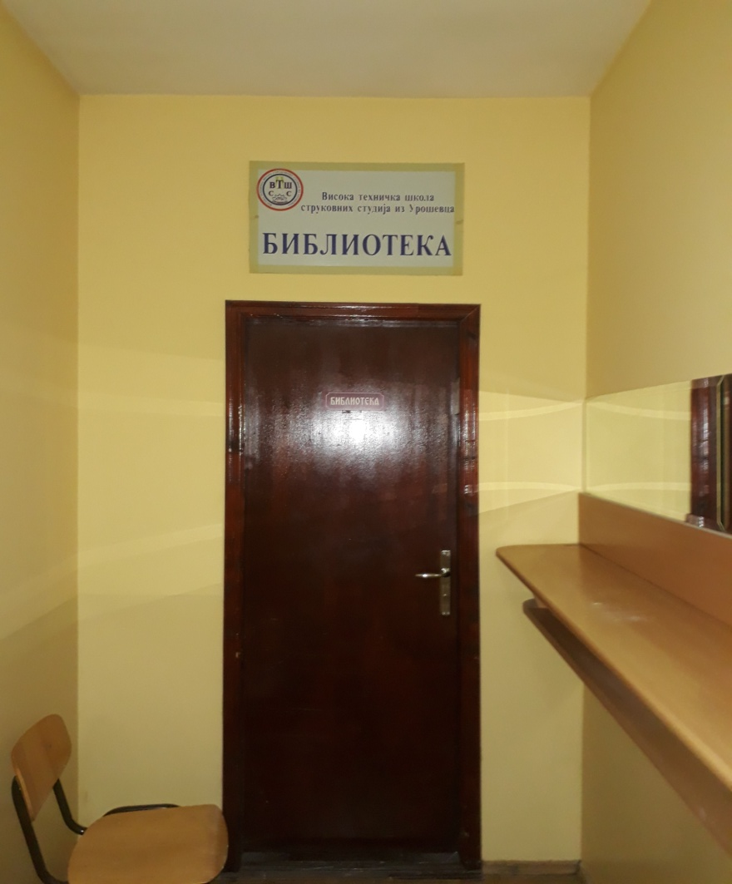
Equipment
Development of master curricula for natural disasters risk management in Western Balkan countries

Slide 12
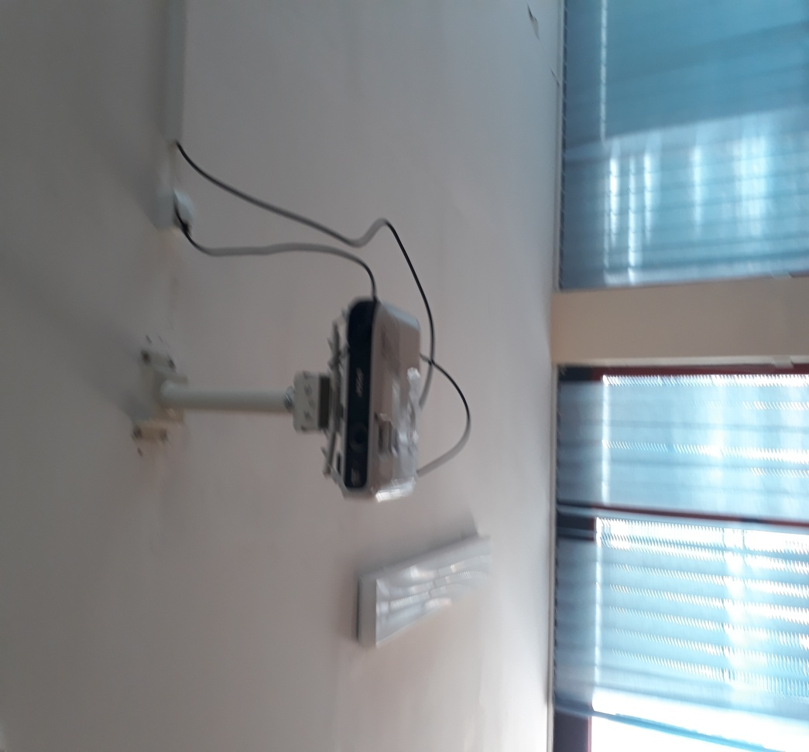
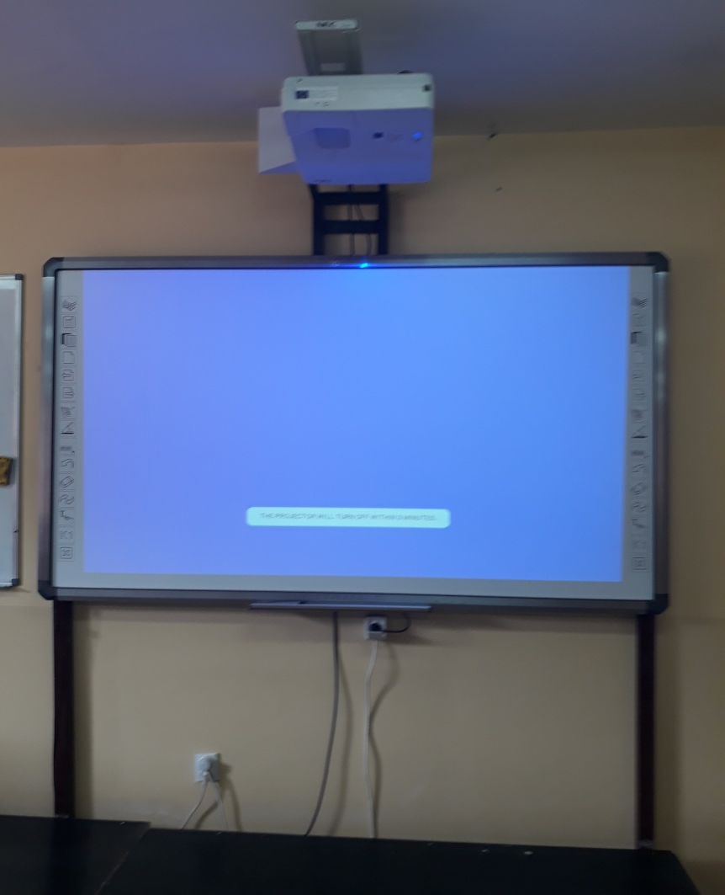
Equipment
Development of master curricula for natural disasters risk management in Western Balkan countries

Slide 13
Equipment
Development of master curricula for natural disasters risk management in Western Balkan countries
The equipment will be used for:
teaching process, lectures, exercises and practical work at the specialist program Disasters Risk Management and Fire safety, established under the NatRisk project, and whose accreditation process has already been initiated;
training of students for effective decision-making in the case of natural disasters;
simulation of different scenarios that may occur due to natural disasters in the virtual environment and how to manage such situations;

Slide 14
Curriculum development
Development of master curricula for natural disasters risk management in Western Balkan countries
A new study program of SPECIALIST PROFESSIONAL STUDIES within the ELEMEND project objectives will be established.
The new study program will last one school year, and students will be awarded with 60 ECTS.
New specialist professional studies curricula for natural disasters risk management was developed and courses and syllabi are defined. The accreditation process is still in progress.

Slide 15
Curriculum development
Development of master curricula for natural disasters risk management in Western Balkan countries
The issues regarding the methodology, learning outcomes, module templates, etc are harmonized with the guidelines and recommendations of EU project partners in the Workshops.
The new study program of Specialist Professional Studies:
Disasters Risk Management and Fire Safety

Slide 16
Curriculum development
Development of master curricula for natural disasters risk management in Western Balkan countries
Disasters Risk Management and Fire Safety | COURSE STATUS | ECTS
English language – higher course | O | 6
Research methods and scientific communications | O | 6
Natural disasters | O | 6
Fire Dynamics and Expertise | O | 6
Elective courses 1 (elect 1 out of 2)
Risks Management Legal Frameworks | E | 6
Information and communication technologies in risk management | E | 6
Fire Extinguishers and equipment | O | 7
Natural disasters risk management | O | 7

Slide 17
Curriculum development
Development of master curricula for natural disasters risk management in Western Balkan countries
Disasters Risk Management and Fire Safety | COURSE STATUS | ECTS
Elective courses 2 (elect 1 out of 3)
Management and development of human resources in the protection | E | 6
Sustainable development and environmental protection | E | 6
Protection and rescue | E | 6
Professional practice | O | 2
Specialist Thesis | O | 8
 | Total ECTS | 60

Slide 18
Thank you for your attention!
Development of master curricula for natural disasters risk management in Western Balkan countries

